Slide 1
Graphs and their Properties
Jorge A. Cobb
The University of Texas at Dallas

Slide 2
Graphs
Graphs are a representation of relations, highlighting a number of interesting problems (graph theory)
  isomorphism, connectivity, planar graphs, path algorithms
Graphs have many applications in modeling where entities are related/connected to other entities

Slide 3
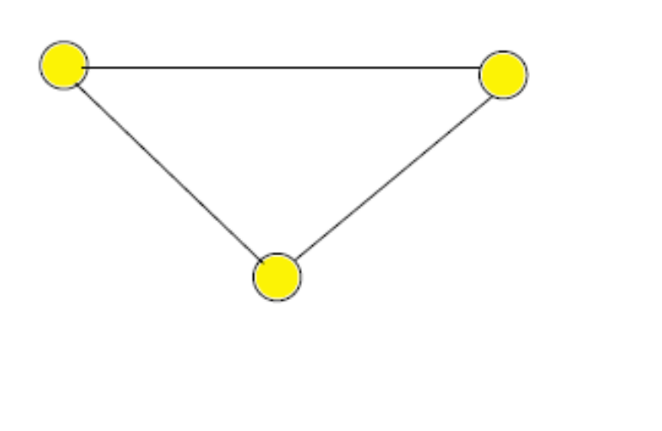
Graph Example
v₃
v₁
v₂

Slide 4
Graph definitions
A graph G = (V, E) is a pair of sets, where elements of E connect two elements of V
The elements of V are the vertices, or nodes
The elements of E are the edges, or arcs, which are pairs of vertices.
For the edge e = (v₁, v₂)
  has as endpoints v₁ and v₂
  it is incident with v₁ and v₂.
  v₁ and v₂ are adjacent or neighbors.
  v₁ is the initial vertex and v₂ is the terminal vertex (if the pair is ordered, more on that later).

Slide 5
Graph Example
v₃
v₁
v₂

Slide 6
Graph types
Multigraph: General E with multiple edges between the same pair of vertices.
Simple graph: No multiple edges and no (self) loops;
Directed / undirected graph: Edges go in a specific direction, or are always symmetric.
Combinations of the above: for example, directed simple graph

Slide 7
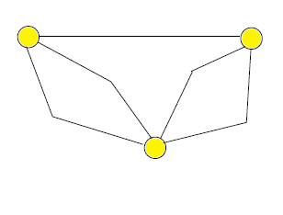
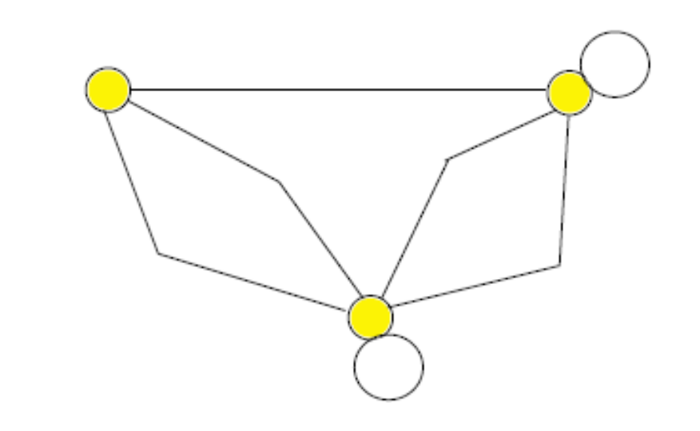

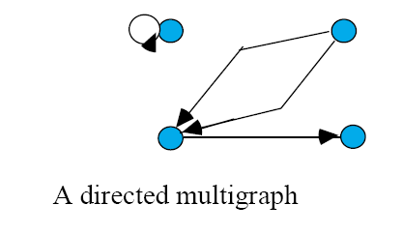
Undirected multigraph
Simple undirected graph

Slide 8
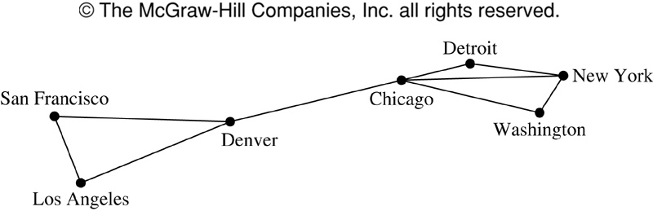
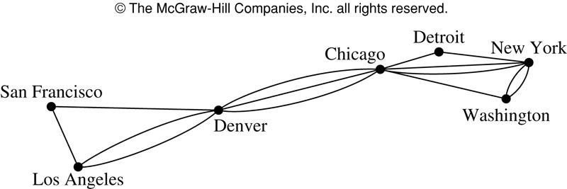
Computer Networks as undirected graphs
a

Slide 9
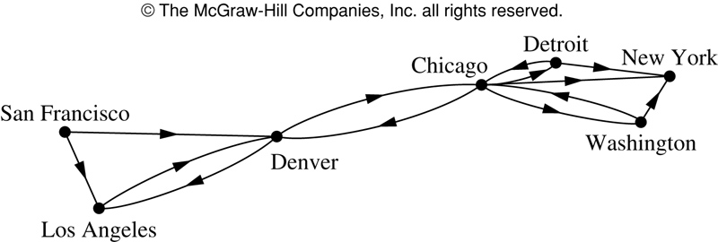
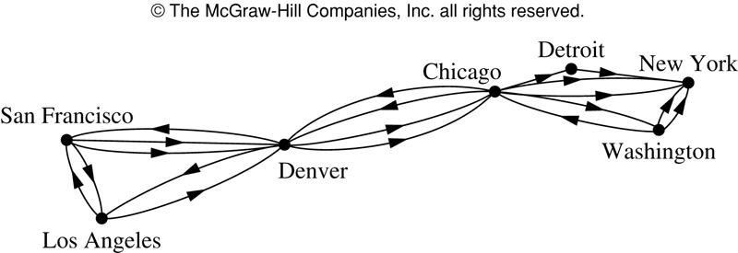
Computer Networks as directed graphs

Slide 10
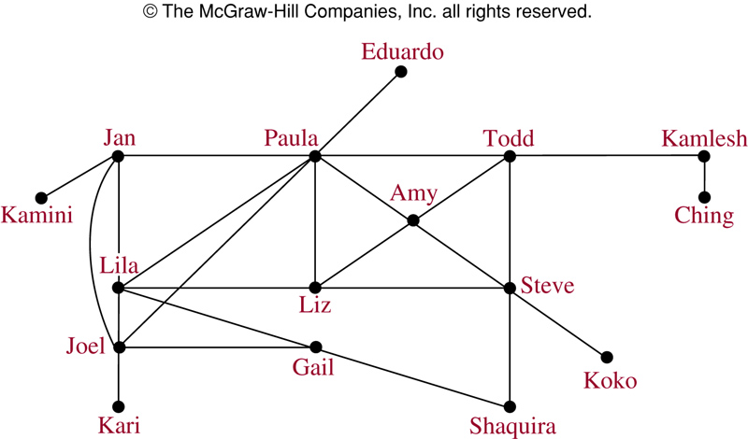
Acquaintanceship graphs
Who is acquainted with whom?
  simple undirected

Slide 11
Collaboration graphs
Hollywood graph
  Vertices are actors
  Edge (v₁,v₂) iff actor v₁ has done a movie with actor v₂
  simple undirected
  Hollywood graph: 640,000 actors in 340,000 films, with 20 million edges (January 2006)

Slide 12
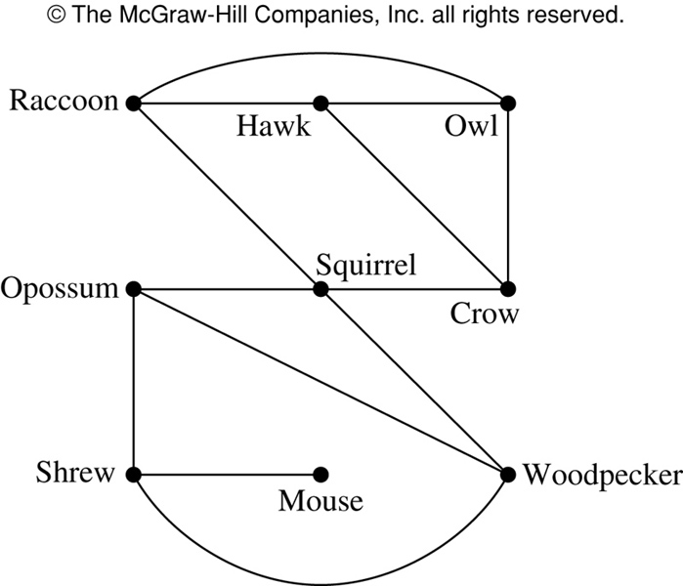
Nice Overlap Graphs
Two species are related if they compete for the same resources (food, shelter)

Slide 13
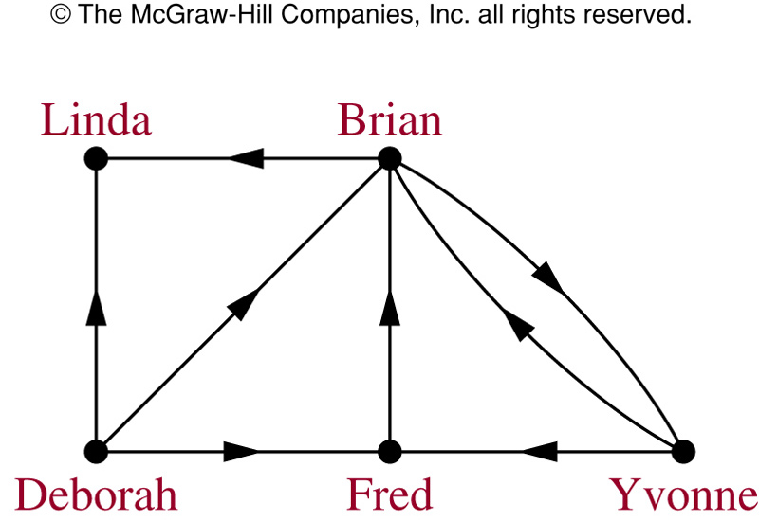
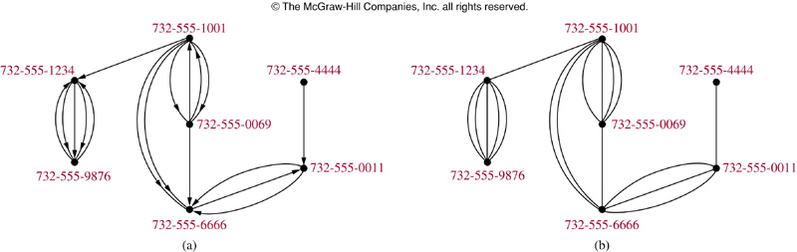
Modeling with graphs
Influence graphs
  simple directed
Call graphs
  multigraph, directed
  20 days of call data from AT&T
    290 million vertices, 4 billion edges

Slide 14
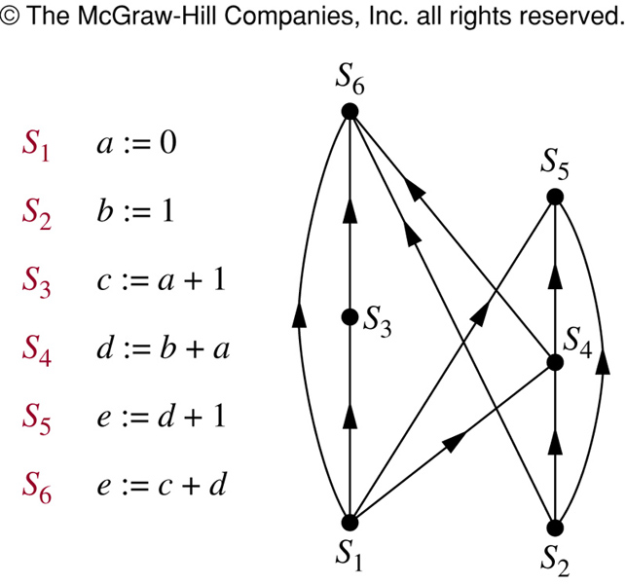
Precedence graphs
task scheduling, concurrent processing
simple, must be directed and antisymmetric

Slide 15
Modeling with graphs
The World Wide Web
  simple directed
  3 billion vertices, 20 billions edges
Roadmaps
  simple/multigraph, directed/undirected
  leads to problems such as the Traveling Salesman’s problem

Slide 16
Degree of vertices
The degree of a vertex v deg(v) is the number of edges with v as an endpoint, except that a loop adds 2 to the degree.
If the graph is directed, the in-degree of v deg⁻(v) is the number of edges with v as terminal vertex. Similarly, the out-degree of v deg⁺(v) is the number of edges with v as initial vertex.
Special cases:
  Isolated vertex: degree 0.
  Pendant vertex: degree 1.

Slide 17
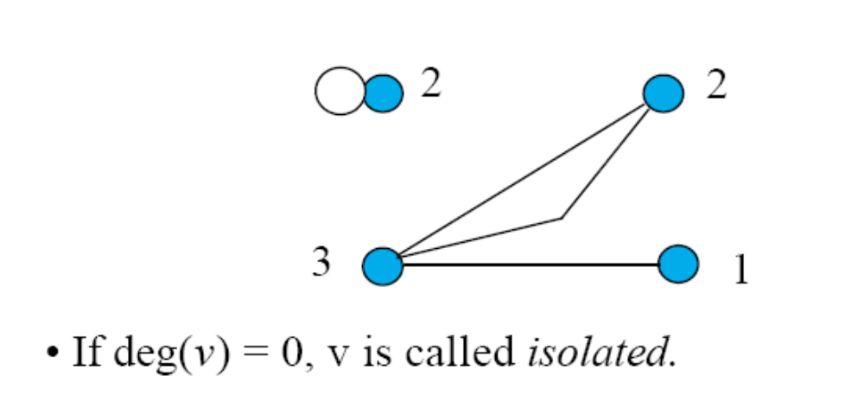


Slide 18
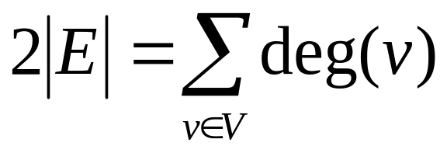
The Handshaking Theorem
Let G = (V, E) be an undirected graph. Then,
Proof: Each edge contributes to the sum twice, once for each endpoint (possibly the same).

Slide 19
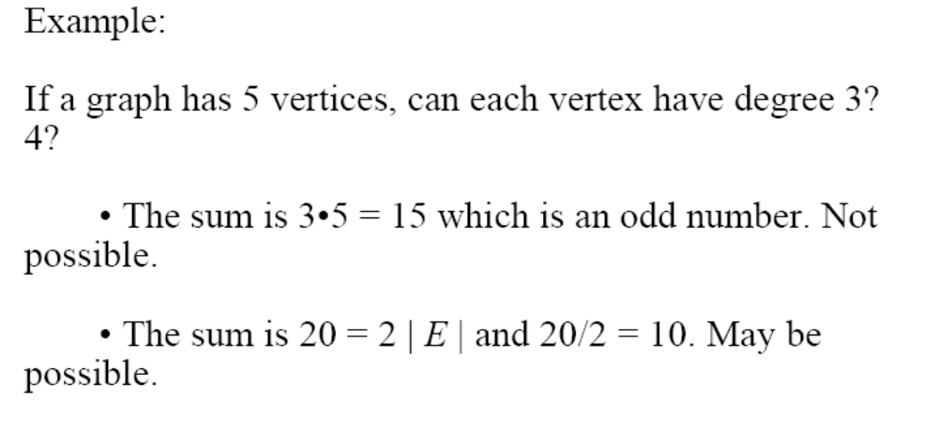

Slide 20
Another example
How many edges are there in an undirected graph with 10 vertices each of degree six?
  Sum of the degrees of vertices 6*10 = 60
  2|E| = 60
  |E| = 30

Slide 21
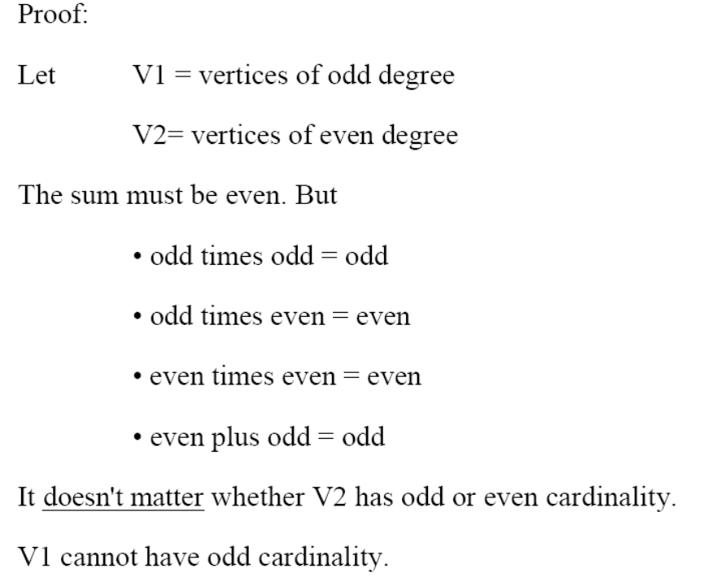
Odd-Even degrees
Corollary: An undirected graph has an even number of vertices of odd degree.

Slide 22
Example
It is not possible to have an undirected graph with 3 vertices each of which has degree 1.

Slide 23
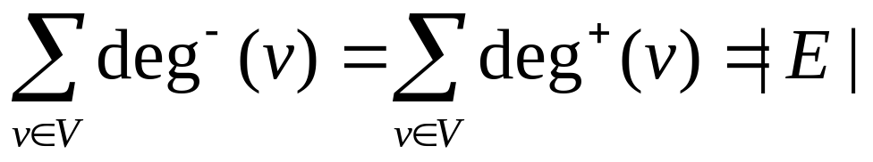
Obvious theorem ☺
For any directed graph G = (V,E),

Slide 24
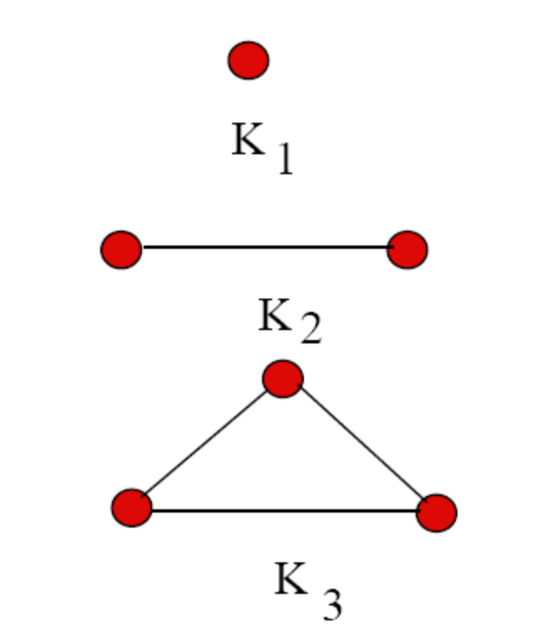
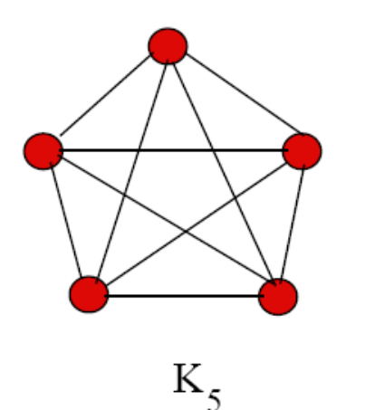
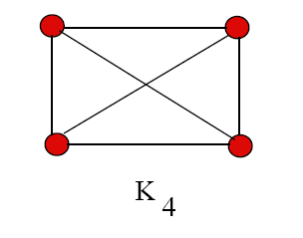
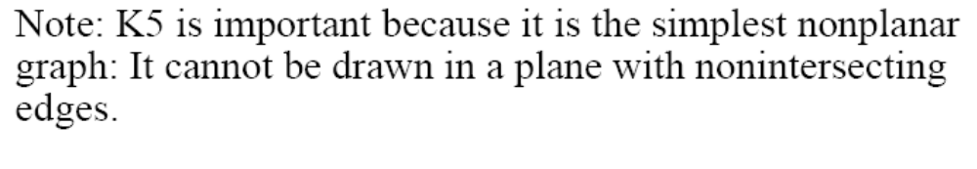
Special simple undirected graphs
Complete graphs with n vertices, K_{n}:
  Every vertex is connected to every other vertex
  (n² – n)/2 edges

Slide 25
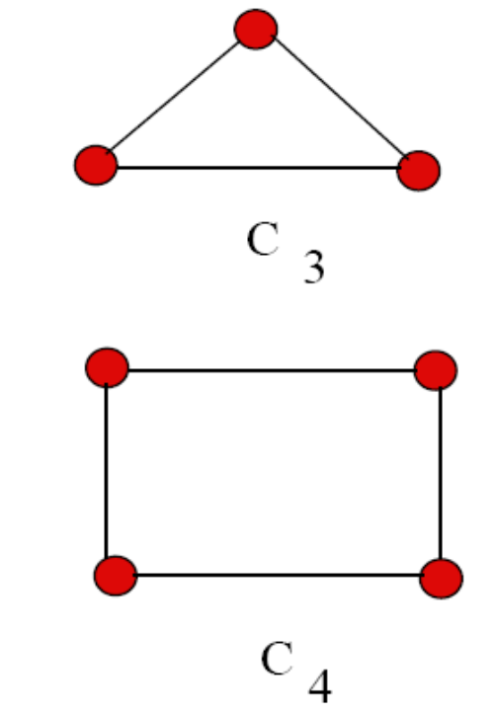
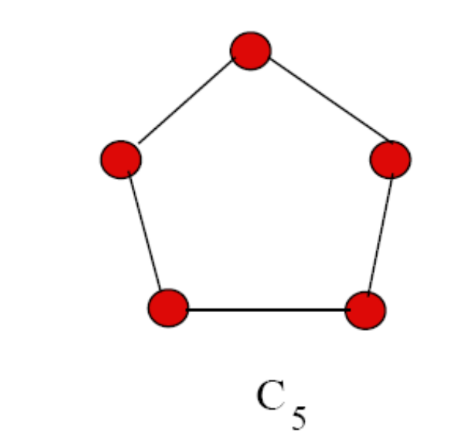
More Simple Undirected Graphs
Cycles with n vertices, C_{n}:
  Edges are (v₁, v₂), (v₂, v₃), ..., (v_{n-1}, v_{n}), (v_{n}, v₁)

Slide 26
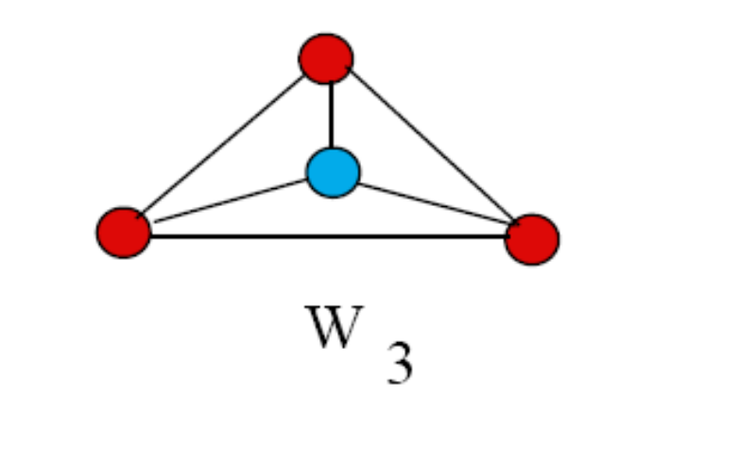
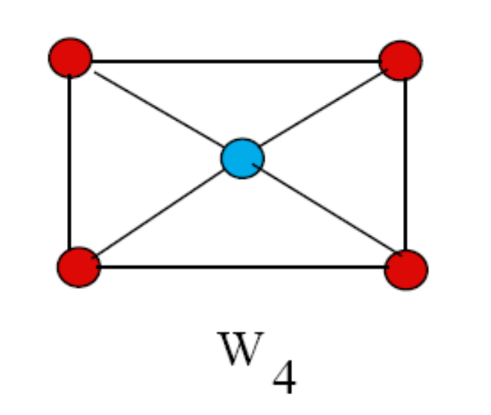
More Simple Undirected Graphs
Wheels W_{n}:
  Cycle C_{n} plus an extra vertex v₀ and all edges between v₀ and v₁, v₂, ..., v_{n}
  Provides redundancy in local area networks

Slide 27
Hypercubes
The n-dimensional hypercube Q_{n} is the graph with vertices corresponding to the 2^{n} bit strings of length n, and edges between any such vertices that differ in one bit position
00
01
0
1
10
11

Slide 28
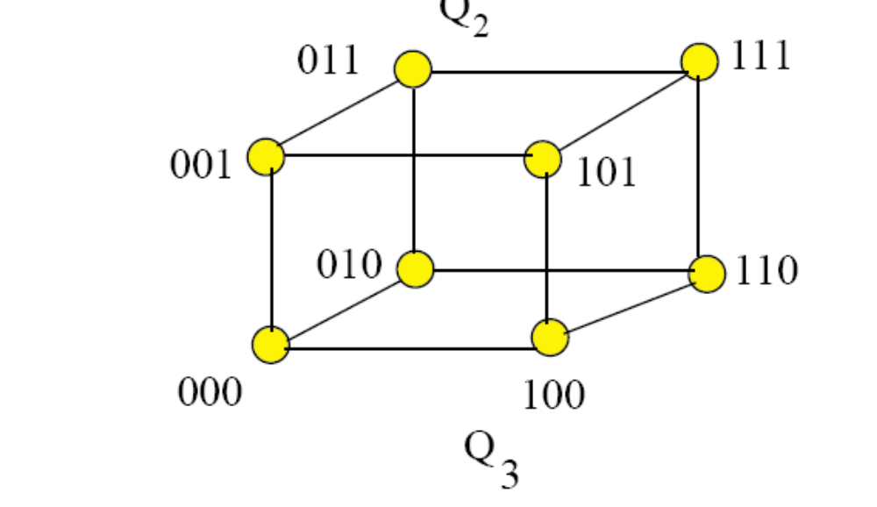
What is the minimum number of hops to go from any node to any other node if
we have degree n (2^n) nodes?

Slide 29
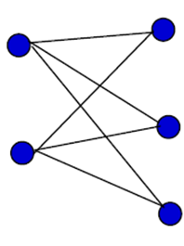
Bipartite graphs
A simple graph is bipartite if its vertices can be partitioned in two subsets V₁ and V₂ such that no edge connects two elements of V₁ or two elements of V₂.
Special case: The complete bipartite graph K_{n1},_{n2} is a bipartite graph with |V₁| = n₁ and |V₂| = n₂ where every possible edge between elements of V₁ and elements of V₂ exists.

Slide 30
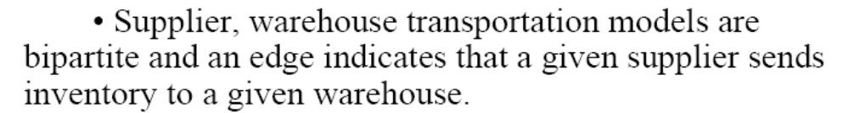
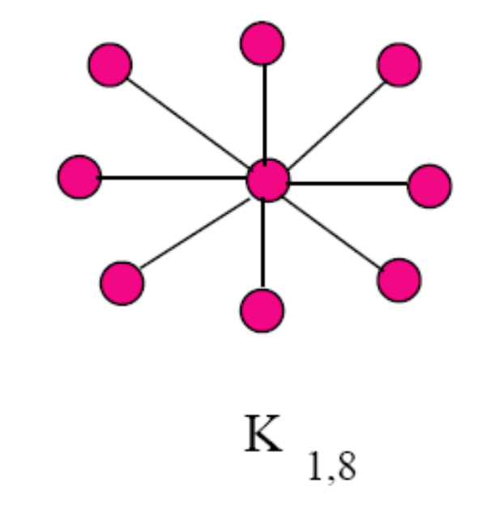

Slide 31
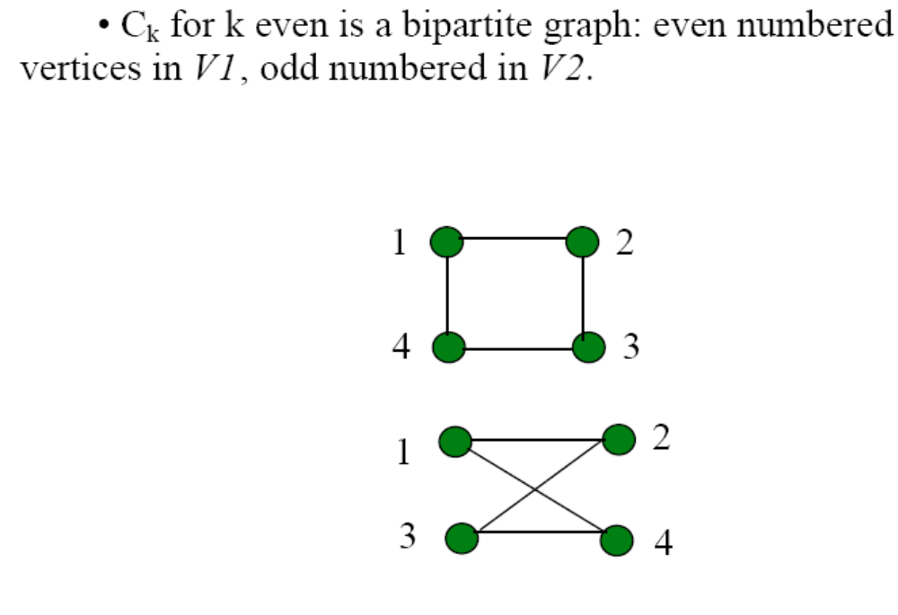

Slide 32
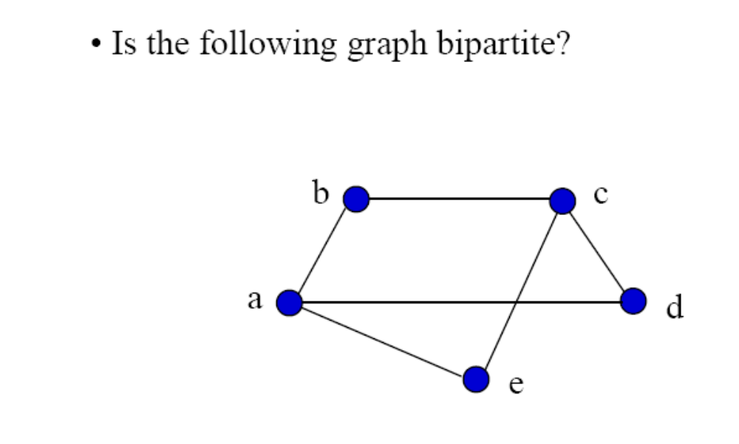

Slide 33
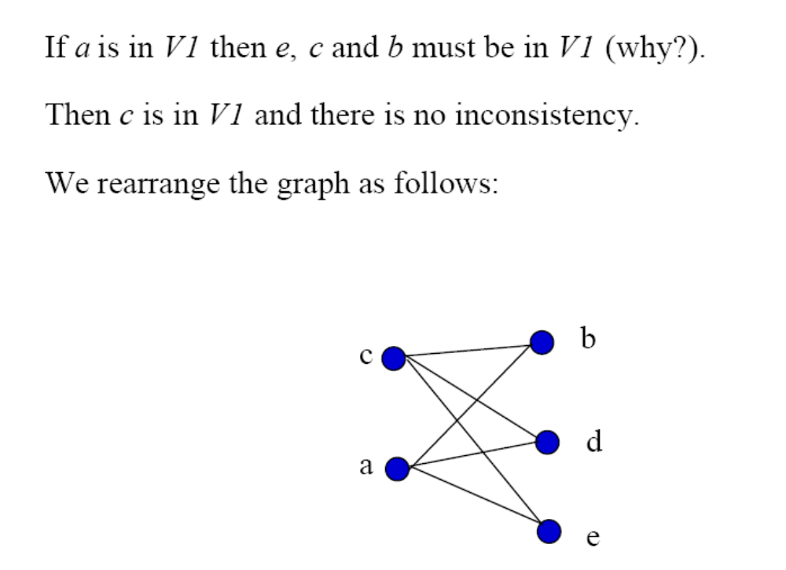
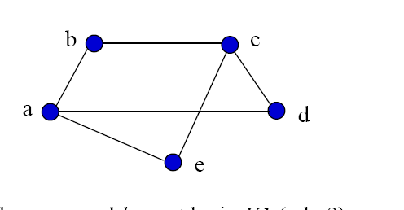
d
V2

Slide 34
Properties of bipartite graphs
Graph coloring: The problem of assigning colors to vertices so that vertices of the same color are not adjacent
Theorem: A bipartite graph can be colored with two colors (and vice versa)
Theorem: A bipartite graph is one where all cycles have even length.

Slide 35
Subgraphs and unions
A graph G₁ = (V₁, E₁) is a subgraph of another graph G₂ = (V₂, E₂) if V₁ ⊆ V₂ and E₁ ⊆ E₂. If these two graphs are not the same, G₁ is a proper subgraph of G₂.
The union of two simple graphs G₁ = (V₁, E₁) and G₂ = (V₂, E₂) is the simple graph G = (V, E) with V = V₁ ∪ V₂ and E = E₁ ∪ E₂.

Slide 36
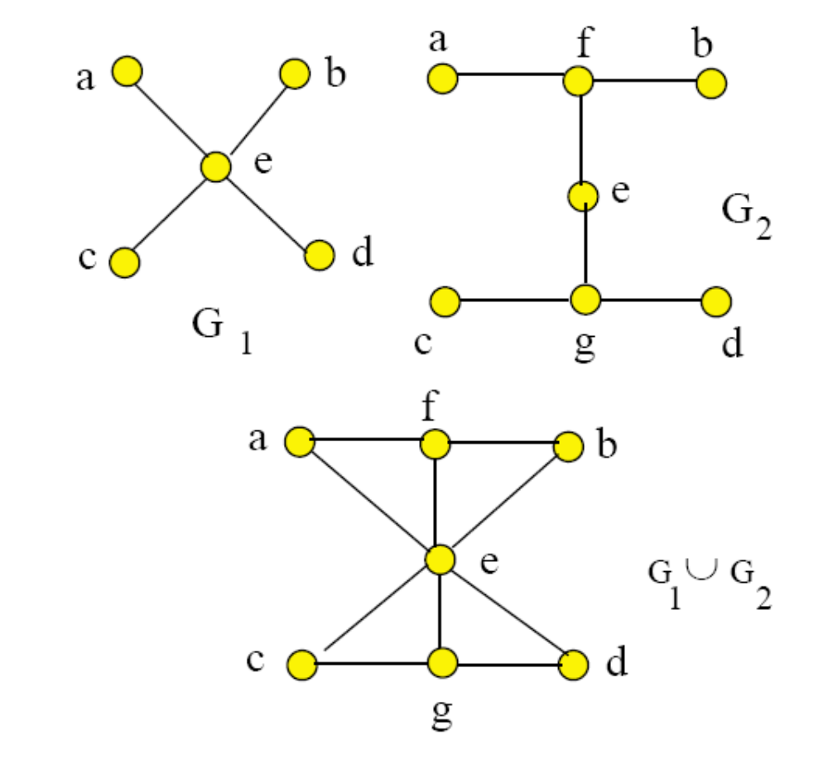

Slide 37
